Slide 1
11 – Clean Code – Liskov Substitution Principle (LSP)
Based on the CleanCoders videos by Uncle Bob Martin
Rupert Waldron

Slide 2
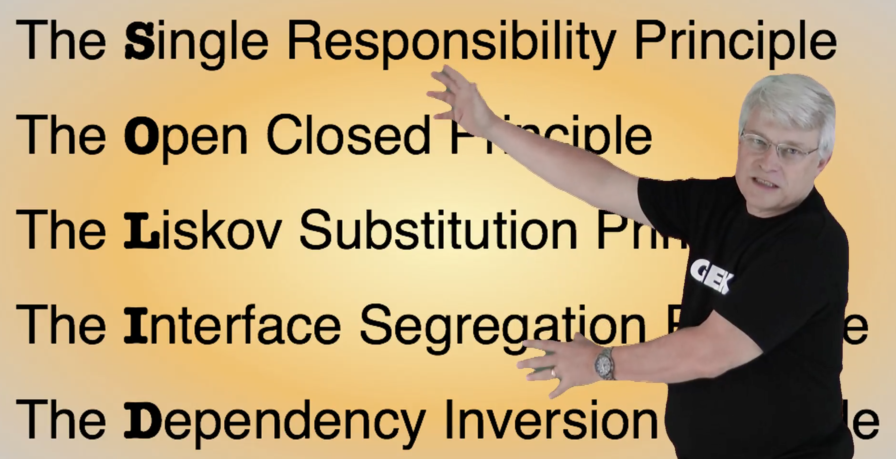
Object Orientated Design is all about Dependency Management
Uncle Bob gives us these dependency management principles that control operations and relationships between classes

Slide 3
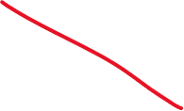


What is a type?
Types are not data structures they are the methods that work with the hidden data. A sub-type is also a collection of methods.
If the sub-type is to be substitutable for its parent it must have the same methods in it as the parent type. But can have different implementations.
public class Point { public double x; public double y; }
A type is a bag of methods
public class Point { public double x; public double y; public void translate(double dx, double dy) { x += dx; y += dy; } }
No operations

Slide 4
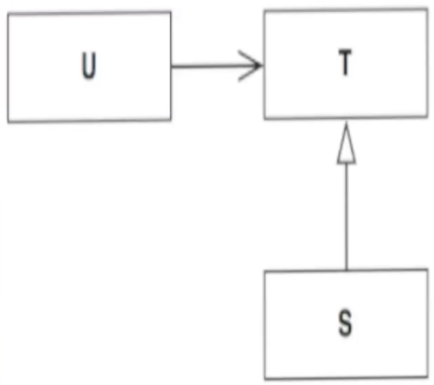
Liskov Substitution Principle
“What is wanted here is something like following substitution property: If for each object O1 of type S there is an object O2 of type T such that for all programs P defined in terms of T, the behaviour of P is unchanged when O1 is substituted for O2 then S is a subtype of T” - Barbara Liskov
In dynamically typed languages this refers to Duck Typing – if the object can respond to the same method calls it is ok.
In statically typed languages this refers to inheritance
"If it looks like a duck and quacks like a duck, it's a duck"
Dynamic languages don’t rely on inheritance which tends to increase rigidity because all the dependencies of the parent class are inherited. So they are less rigid.
Dynamic languages are more likely to suffer a runtime failure because the compiler doesn’t check the types.

Slide 5
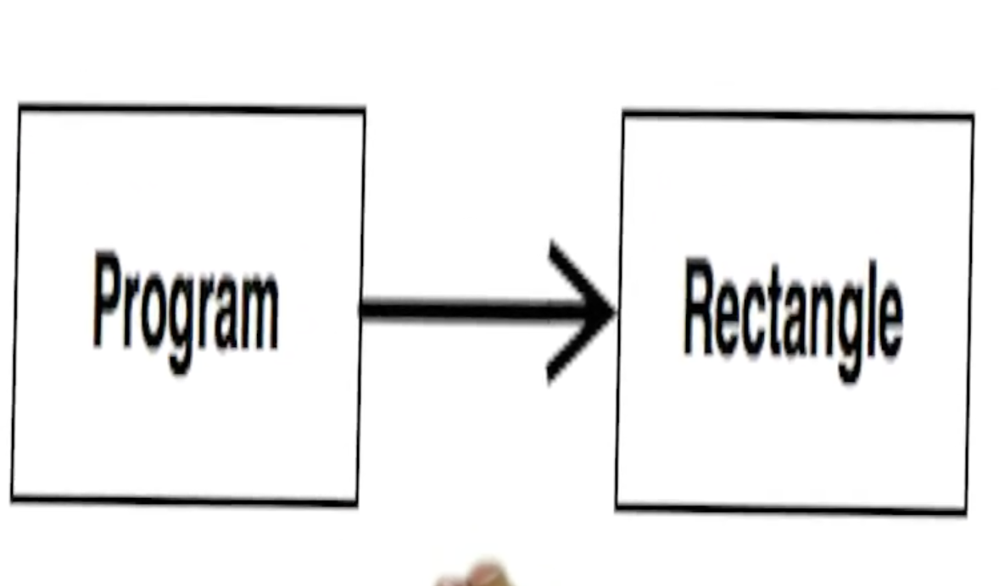
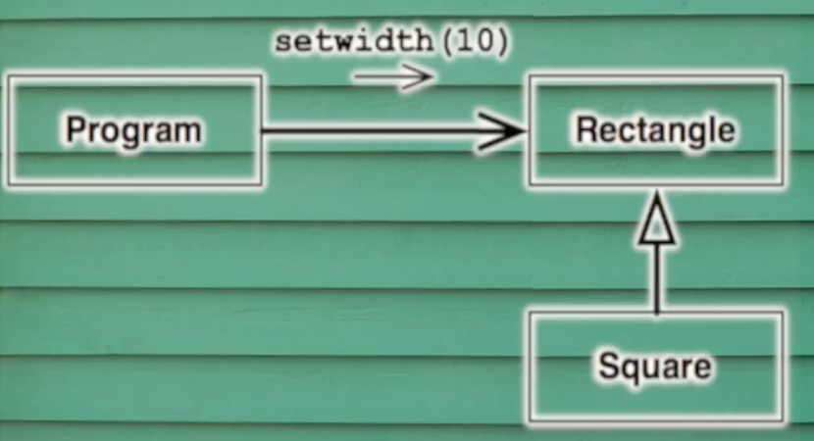
Rectangle
Square is-a Rectangle?
Now need a Square Class
class Square extends Rectangle { @Override public void setHeight(final double height) { super.setHeight(height); super.setWidth(height); } @Override public void setWidth(final double width) { setHeight(width); } }
Square is now inheriting methods it doesn’t need, it really just needs a setSide() method

Slide 6
Refused Bequest
The program has the right to expect that when it changes the width of the rectangle the height remains unchanged.
But if a Square gets passed into this module when the height will get changed when the width gets changed.
The program didn’t expect the height to change, this results in undefined behaviour i.e. it works perfectly on your laptop but in production it will crash and delete all the master files… or you will spend weeks debugging a problem that occurs once per day.

Slide 7
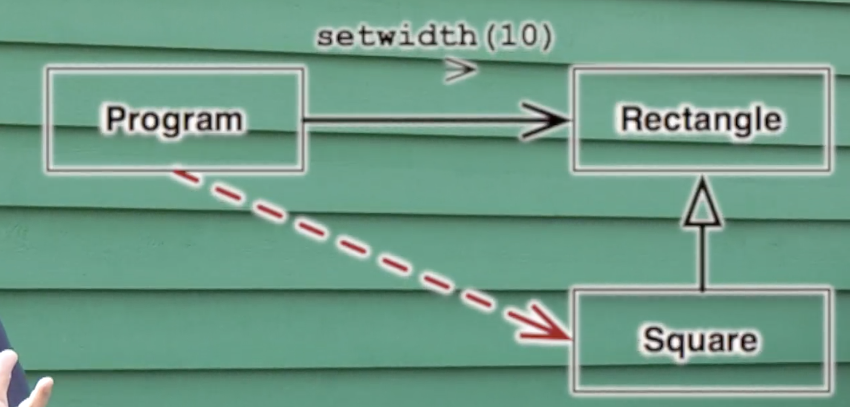
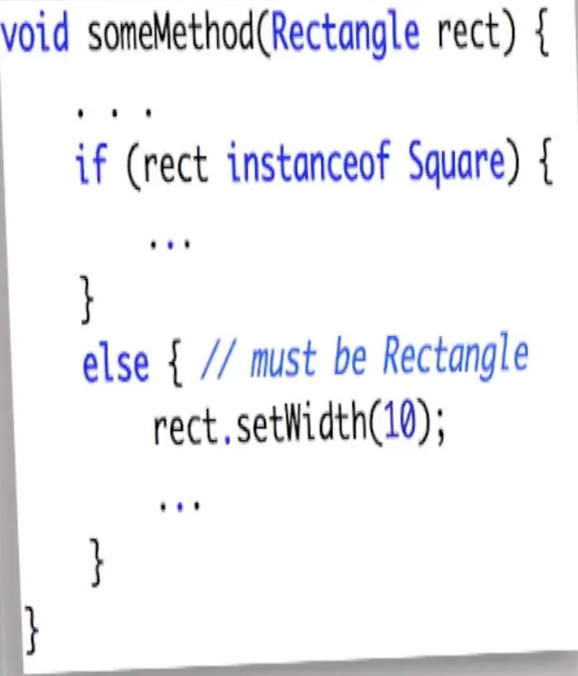

Let’s fix it
Uh oh… now we have instanceof over the the code and we have coupled the program to the Square class – an OCP violation.

Slide 8
Lets fix it again
1) Make the class immutable – get rid of the setters - still going to have height and width in the square.
2) Have Rectangle derive from Square… what to call the other side?
3) Treat them as completely different types and never try to pass a Square into something that expects a Rectangle? But surely a square ”is a” rectangle? Trouble is this Rectangle class represents a Rectangle but it is NOT a rectangle
This is the problem with representatives – they don’t necessarily have the same relationships of the things they represent.

Slide 9
The subclasses should do what the caller expects
1 interface Shape {
2 void draw();
3 }
4
5 class Circle implements Shape {
6 public void draw() {
7 System.out.println("I'm round");
8 }
9 }
1 class CardDealer implements Shape {
2 private final Deck cards ;
3
4 CardDealer( final Deck cards) {
5 this.cards = cards;
6 }
7
8 public void draw() {
9 Card next = cards.next();
10 System.out.println(next.asText());
11 }
12 }
1 List<Shape> shapes = List.of( new Circle(), new CardDealer());
2 shapes.forEach( Shape::draw );

Slide 10
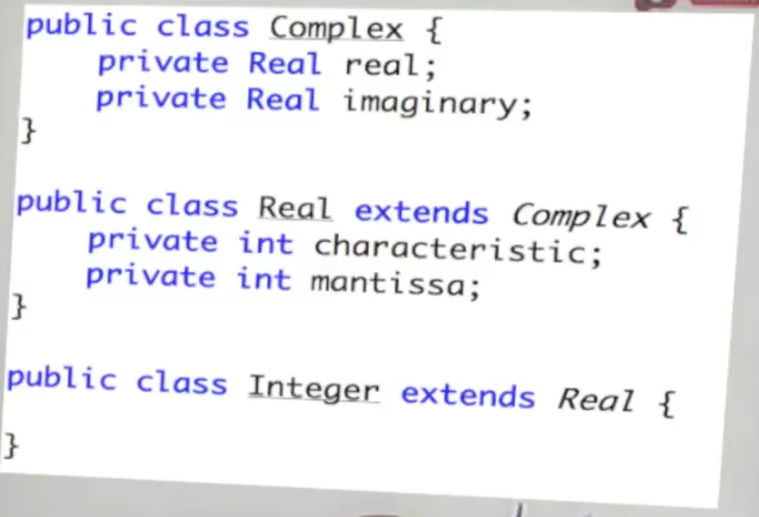
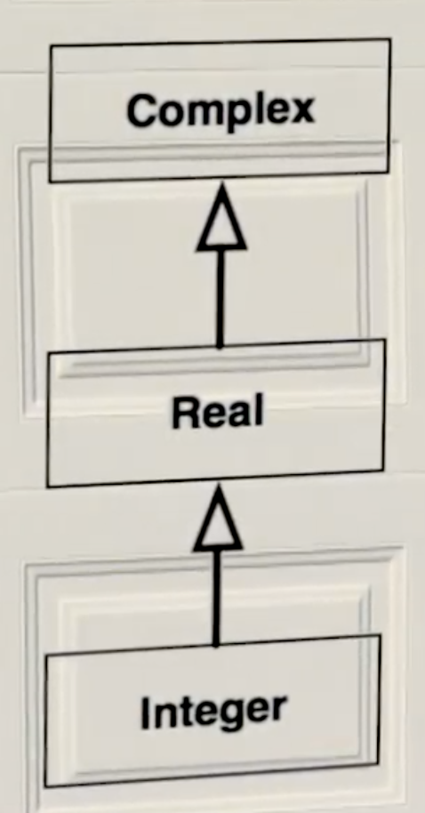
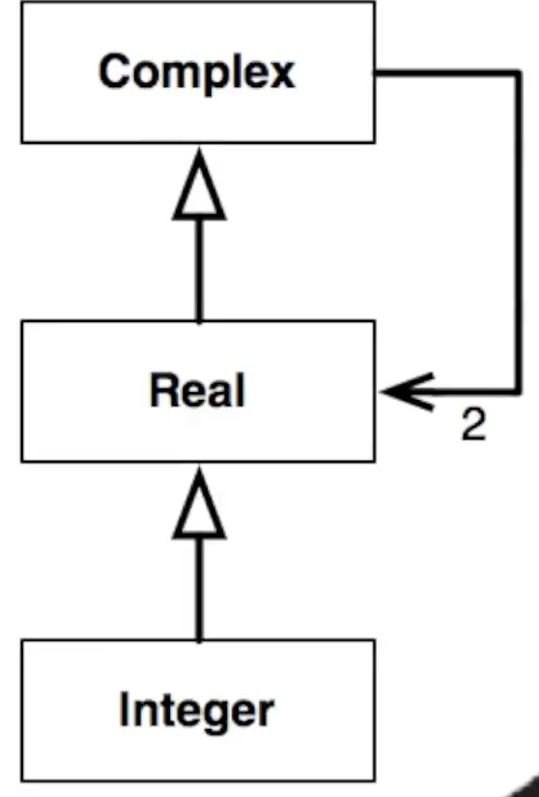
Consider Integer
Stackoverflow
This makes perfect sense in the real world but no sense at all inside a computer

Slide 11
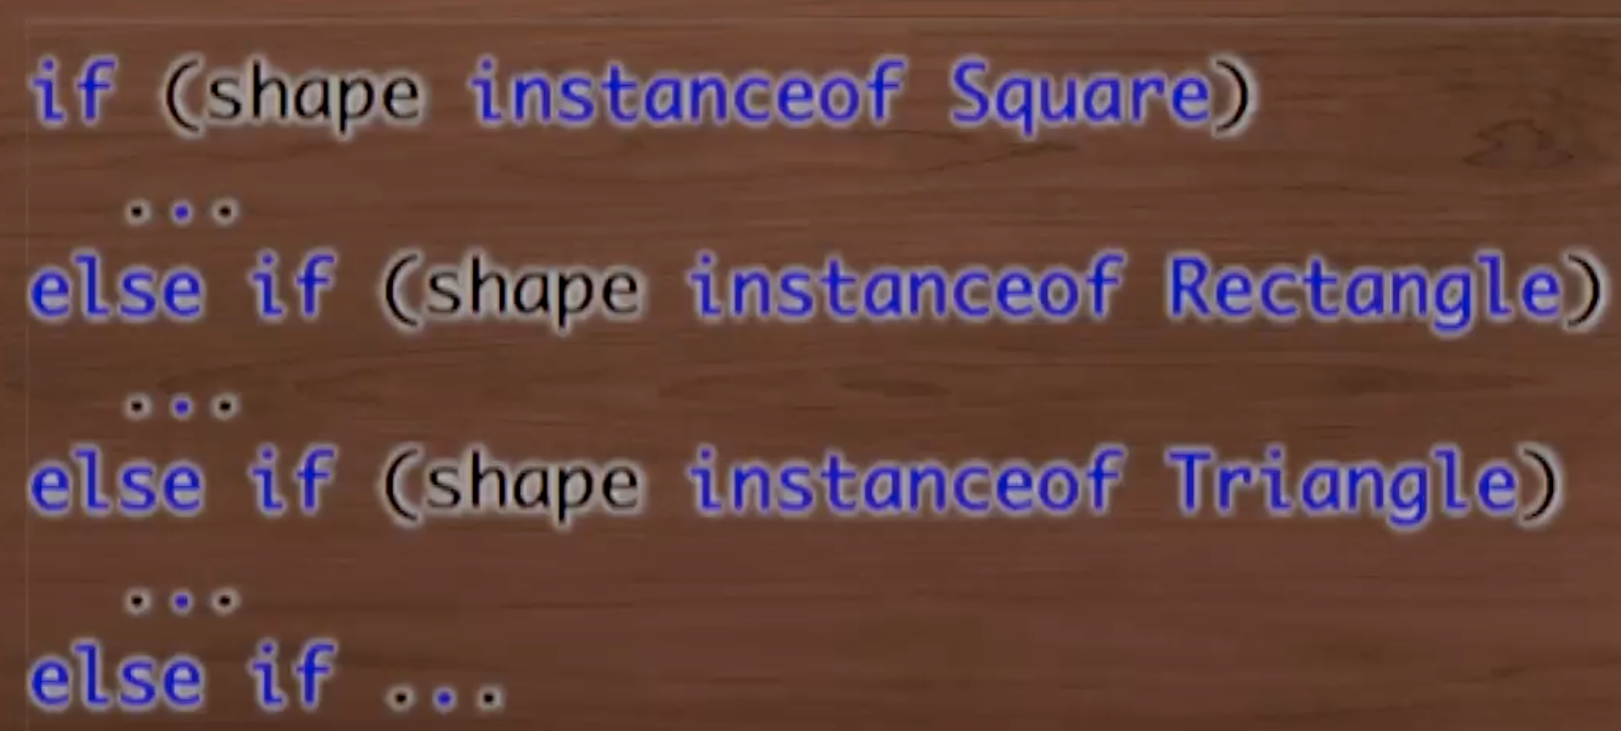
How to spot LSP Violations
If the base class does something, the derived class does should do it to and does it in a way that does not violate the expectations of the callers.
A subtype can do more than it’s parent type, but can never do less. Finding f() {} is often suspicious so is when the derived function just throws an exception.
The presence of the if instanceof statement. Rule… you are allowed to check the type of an instance if you already know what type it is.
If instance of only really becomes a problem if there is an else as well.

Slide 12
Lists
List<Circle> is not a subtype of List<Shape>
public class ListTypes { public static void main(String[] args) { List<Circle> circles = new ArrayList<>(); circles.add(new Circle()); produceStuff(circles); List<Blob> blobs = new ArrayList<>(); blobs.add(new Circle()); consumeStuff(blobs); } private static void produceStuff(List<? extends Shape> l) { l.forEach(s -> System.out.println(s.whatAmI())); } private static void consumeStuff(List<? super Shape> l) { l.add(new Square()); } }
abstract class Blob {} abstract class Shape extends Blob { abstract String whatAmI(); } class Circle extends Shape { @Override String whatAmI() { return "circle"; } } class Square extends Shape { @Override String whatAmI() { return "square"; } }

